Slide 1


Subhransu Sekhar
Mohanty
30/01/2022

Slide 2

Outline
Executive Summary
Introduction
Methodology
Results
Conclusion
Appendix
<number>
Notes:
<number>

Slide 3
Executive Summary
Data was collected using APIs and webscrapping. Then datasets were cleaned and went through exploratory data analysis to extract valuable insights from them. Then datasets were feature engineered to be fed into ML classifers. Train models performed decently and produced somewhat accurate results.
We observed that missions are more likely to be successful each upcoming year due to newer booster technologies. Missions to orbits that are farther to earth have higher success rate. Proximity of the launchsite to the coastline is a factor for mission success. Payload mass positively correlates with success rate.
2

Slide 4
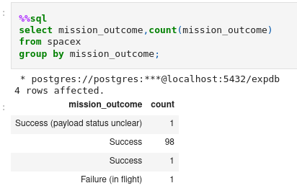
Total Number of Successful and Failure Mission Outcomes
This sql query showed the total value counts of each mission outcomes.
3

Slide 5
Introduction
This project is created to help create a new space startup named
SpaceY which will compete SpaceX. We are thus using past launch
records of Falcon-9 rocket to get insights from for our new startup.
We are finding which factors affect mission success in which way. We also want to find out long term trends in the data.
4

Slide 6

Section 1
5

Slide 7
Methodology
Data collection
API and Web-scrapping
Perform data wrangling
Cleaning, Imputation, Feature Engineering
Perform exploratory data analysis (EDA) using visualization and SQL
Perform interactive visual analytics using Folium and Plotly Dash
Perform predictive analysis using classification models
Building, tuning, evaluating classification models
5
Notes:
<number>

Slide 8
Data Collection
Some data sets were collected by web-scrapping. We used BeautifulSoup
Package to parse the HTML contents which were downloaded using the get function of requests library.
Other datasets were collected using SpaceX APIs.
Now let’s move on to see how datasets were collected using both the processes.
7

Slide 9
Data Collection – SpaceX API
It is the visualized data collection process with SpaceX REST API.
This is the GitHub URL of the completed SpaceX API calls notebook.
Start
Import Pandas, Requests,
Numpy and DateTime
Call the api using get function
Of requests and relevant URL
Decode the response as a Json
& turn it into a Pandas dataframe
Using relevant functions
Filter, wrangle and clean and save the data
End
8

Slide 10
Data Collection - Scraping
This flowchart represents how we scrapped the wikipedia webpage and got the desired dataframe.
This is the GitHub URL of my web scraping notebook.
Start
Import Pandas, Requests,
BeautifulSoup & DateTime
Request the Falcon9 Launch
Wiki page from its URL
Extract all column names
from the HTML table header
Create a data frame by
Parsing the launch
HTML tables
End
9

Slide 11
Data Wrangling
Import Libraries and Define Auxiliary Functions
Import the data-frame from the previously saved csv file
Identify Column names and their types
Create a landing outcome label from Outcome column
Determine the average success rate from the mean of
landing outcome column
Create dummy variables from categorical variables and
remove the original categorical columns
Save the modified dataframe
This is the GitHub URL of my completed data wrangling notebooks as an external reference.
10

Slide 12
Data Wrangling Flowchart
Start
Import libraries
Define auxiliary functions
Import the previously saved csv file
As a pandas dataframe
Create a landing outcome
label from Outcome column
Replace the categorical variables with
their dummy counterparts
Save the modified datatable
End

Slide 13
EDA with Data Visualization
There are 2 previously plotted scatterplots in the notebook. The significance of drawn graphs are given below.
The first scatterplot visualizes the relationship between flight number and launch sites for both successful and failed missions.
The second scatterplot depicts the relationship between payload mass and launch sites for both successful and failed missions.
The column graph shows the relationship between success rate of each orbit type.
The third scatterplot represents the relationship between flightNumber and orbit type.
The fifth scatterplot objectifies the relationship between payload mass and orbit type.
The sixth scatterplot picturizes the yearly trend of the launch success.
This is the GitHub URL of my completed EDA with data visualization notebook.
11

Slide 14
EDA with SQL
select unique(launch_site) from spacex;
select * from spacex where launch_site like 'CCA%' limit 5;
select sum(payload_mass__kg_) from spacex where customer = 'NASA (CRS)';
select avg(payload_mass__kg_) from spacex where booster_version='F9 v1.1';
select min(date) from spacex where landing__outcome='Success (ground pad)';
select unique(booster_version) from spacex where landing__outcome='Success (drone ship)' and payload_mass__kg_ between 4000 and 6000;
select mission_outcome,count(mission_outcome) from spacex group by mission_outcome;
select unique(booster_version) from spacex where payload_mass__kg_ = (select max(payload_mass__kg_) from spacex);
select booster_version,launch_site from spacex where year(date)=2015 and landing__outcome='Failure (drone ship)';
select landing__outcome,count(landing__outcome) as counts from spacex where date between '2010-06-04' and '2017-03-20' group by landing__outcome order by counts desc
This is the link to the notebook containing SQL queries and results.
13

Slide 15
Build an Interactive Map with Folium
We added circles and markers on all launch sites on the world map using the coordinates of launch-sites.
For each launches in the data frame,then we, added a folium.Marker to marker cluster and we distinguished the mission success of launch records by using green markers for successful mission outcomes and red ones for failed missions.
Then we marked down a point on the closest coastline using ‘MousePosition’ and calculated the distance between the coastline point and the launch site.
After obtaining its coordinate, create a folium.Marker to show the distance and then we drew a PolyLine between a launch site to the selected coastline point.
This is the link to the notebook containing the codes and result of interactive map with folium.
14

Slide 16
Building a Dashboard with Plotly Dash
We added a piechart and a scatter plot to our dashboard along with a dropdown and a range slider.
The dropdown menu contained options to whether the select the data of all launch sites or just of a single individual site. The range slider lets the user to select the range of payload mass to filter the data.
The piechart shows the total successful launches by site when “ALL” option is selected in the dropdown and total successful and failed launches for a site when a particular site in selected in the menu.
The scatter plot shows the relationship between payload mass and mission success of different booster version categories for selected payload mass range and lauch site(s).
This is the GitHub URL of my completed Plotly Dash lab.
15

Slide 17
Predictive Analysis (Classification)
Scikit-Learn library was used to create ML classifier models for this capstone.
We used the previously wrangled version of data(cleaned and feature engineered) to train our models.
Then we use a standard scaler to normalize all the variables and their values.
To avoiding over-fitting we first split the data to test and train data with random state of 2 and the test to train ratio of 0.2.
We used K-nearest neighbor, decision tree, support vector machine and logistic regression models in this predictive analysis.
We created grid searches for each model to find best parameters for them.
We used train data to train the models and test data to get the accuracy which was the performance metric.
Upon testing we found that all the 4 models performed equally well when using the particular test set and sets of parameters.
This the link to my notebook in my project capstone repository in Github containing ML codes and results and texts.
16

Slide 18
Predictive Analysis Flowchart
Initiate gridsearch objects
using each models as estimators
And paramter dictionaries
Start
Import the libraries and
wrangled data
Normalize features by
Using Standardscaler
Train the data using train data
Test the data using test data
And measure the performance
Using “score” method
Test Train Split
Initiate model objects
Create confusion matrices of
Each models and bargraph
To compare model scores
Create dictionaries of possible
parameters of all the models
for gridsearch
End

Slide 19
Results
We explored the data using SQL queries and visualization and found out the trends and patterns hidden in the data.
We have created interactive dashboard to view the effect of various factors on the mission success.
We created 4 ML classifier models that can predict the probability of mission success upon providing the relevant features. These models perform adequately to roughly estimate the mission success for our startup.
19
Notes:
<number>

Slide 20

Section 2

Slide 21
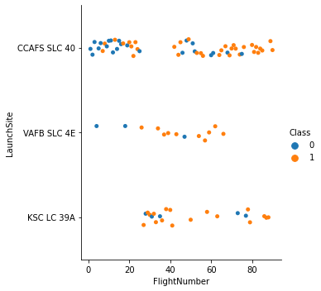
Flight Number vs. Launch Site
19

Slide 22
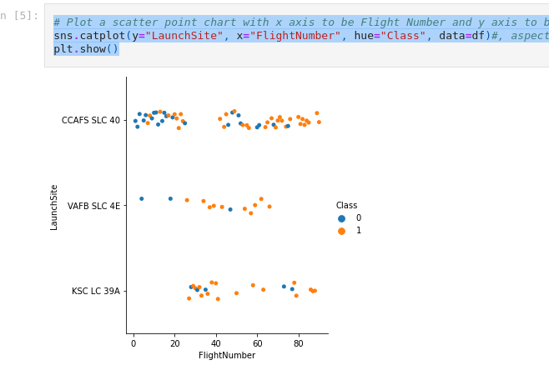
Flight Number vs. Launch Site
This scatter plot shows the relationship between flight number and launch site for both successful and failed missions.
Datapoints of successful missions are orange in colour and datapoints of failed missions are blue in colour.
The horizontal axis shows the flight number.
The vertical axis shows the launch site.

Slide 23
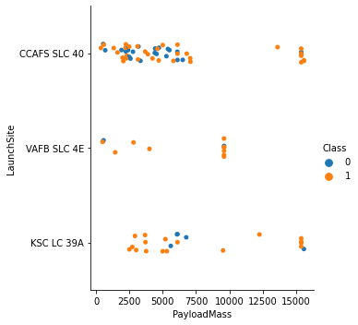
Payload vs. Launch Site
22

Slide 24
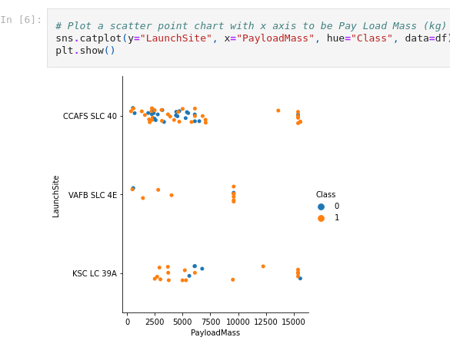
Payload vs. Launch Site
This scatter plot shows the relationship between payload mass and launch site for both successful and failed missions.
Datapoints of successful missions are orange in colour and datapoints of failed missions are blue in colour.
The horizontal axis shows the payload mass(in KG).
The vertical axis shows the launch site.

Slide 25
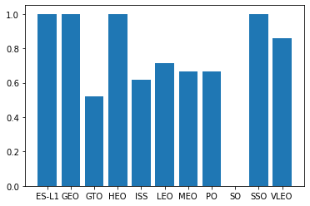
Success Rate vs. Orbit Type
24

Slide 26
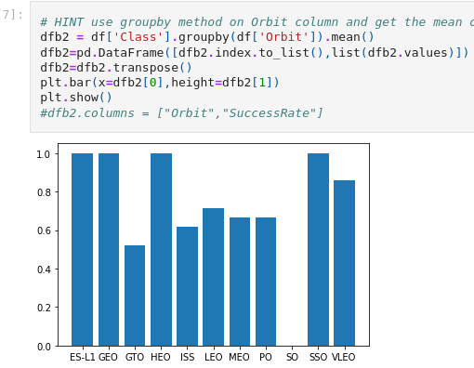
Success Rate vs. Orbit Type
This column chart shows the average success rate of space missions launched to different types of orbits.
Those orbital targets are Sun Synchronous Orbit, Polar Orbit, International Space Station, (High/Low/Middle/Very-Low) Earth Orbit, Geostationary Orbit, Geostationary Transfer Orbit and First Lagrangian Point(ESA L1).
25

Slide 27
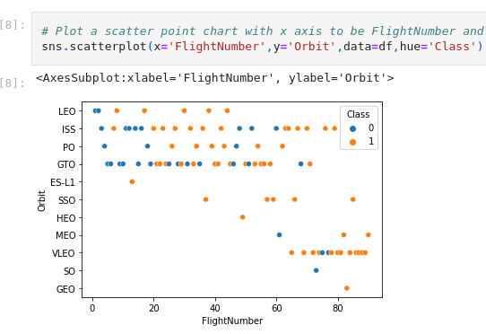
Flight Number vs. Orbit Type
This scatter plot depicts the relationship between flight number and the orbit type.
Here orange data points represent successful missions while blue ones represent failed missions.
26

Slide 28
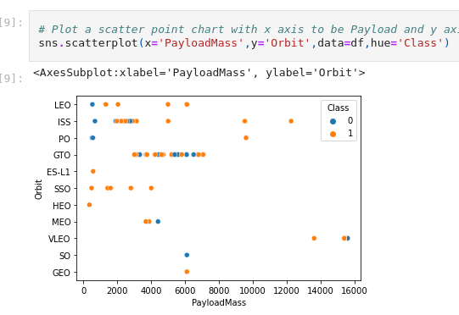
Payload vs. Orbit Type
This scatter plot depicts the relationship between pay load mass and the orbit type.
Here orange data points represent successful missions while blue ones represent failed missions.
The payload mass given here in the horizontal axis is in the unit of Killogram.
We can see missions with heavier payloads are more likely to be successfull.
In case of lighter payloads, 1st Lagrangian point, Sun Synchronous Orbit and High Earth Orbit mission are more likely be successful.
27

Slide 29
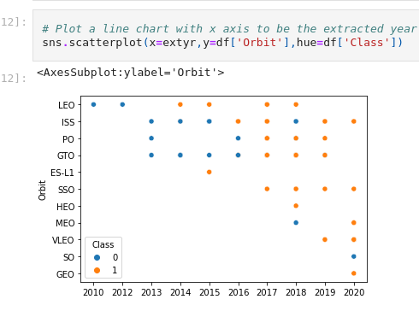
Launch Success Yearly Trend
This graph shows the average success rate of different orbital destinations over the year.
We can see a positive trend here where space launches are more likely to be successful in each successive year than the previous one in all orbit types.
28

Slide 30
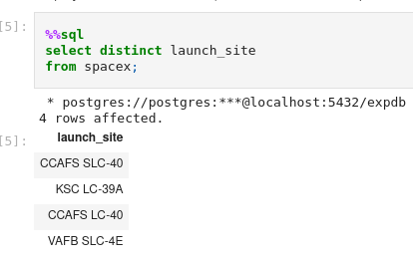
All Launch Site Names
This query seeks the names of the unique launch sites in the space mission.
And we can see the 4 sites as result.
29

Slide 31
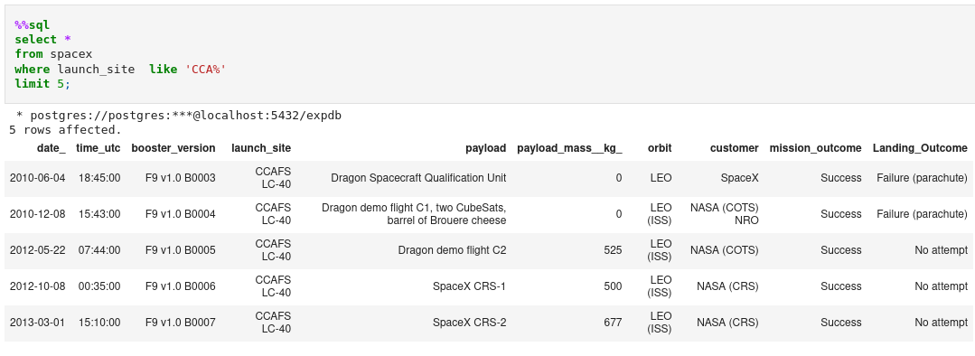
Launch Site Names Begin with 'CCA'
This query seeks 5 records where launch sites begin with the string 'CCA' and we can see the result above.
30

Slide 32
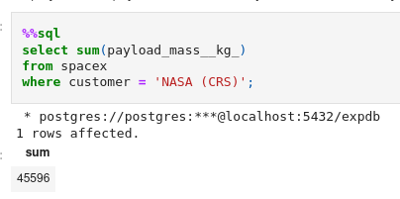
Total Payload Mass
This query resulted in the total payload mass carried by boosters launched by NASA (CRS).
31

Slide 33
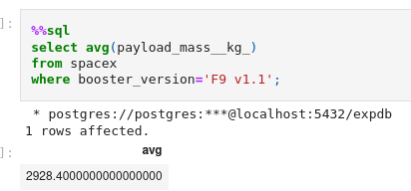
Average Payload Mass by F9 v1.1
This SQL query showed the average payload mass carried by booster version F9 v1.1
32

Slide 34
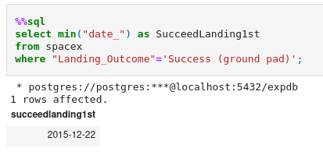
First Successful Ground Landing Date
This query got us date when the first successful landing outcome in ground pad was acheived.
33

Slide 35
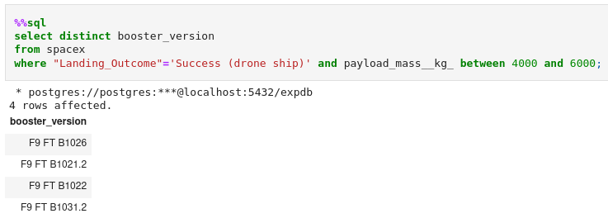
Successful Drone Ship Landing with Payload between 4000 and 6000
This postgres query listed the names of the boosters which have success in drone ship and have payload mass greater than 4000 but less than 6000.
34

Slide 36
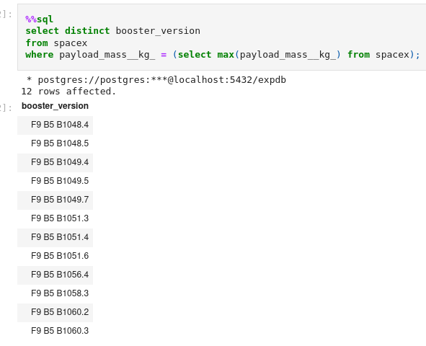
Boosters Carried Maximum Payload
This query provides us the list of the booster_versions which have carried the maximum payload mass.
35

Slide 37
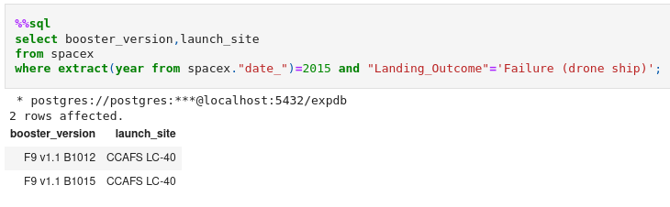
2015 Launch Records
This query lists the failed landing_outcomes in drone ship, their booster versions, and launch site names for in year 2015.
36

Slide 38
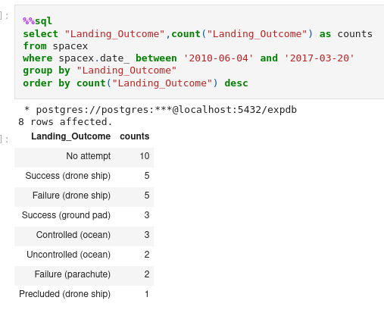
Rank Landing Outcomes Between 2010-06-04 and 2017-03-20
This query ranks the count of landing outcomes between the date 2010-06-04 and 2017-03-20, in descending order.
37

Slide 39

Section 3

Slide 40
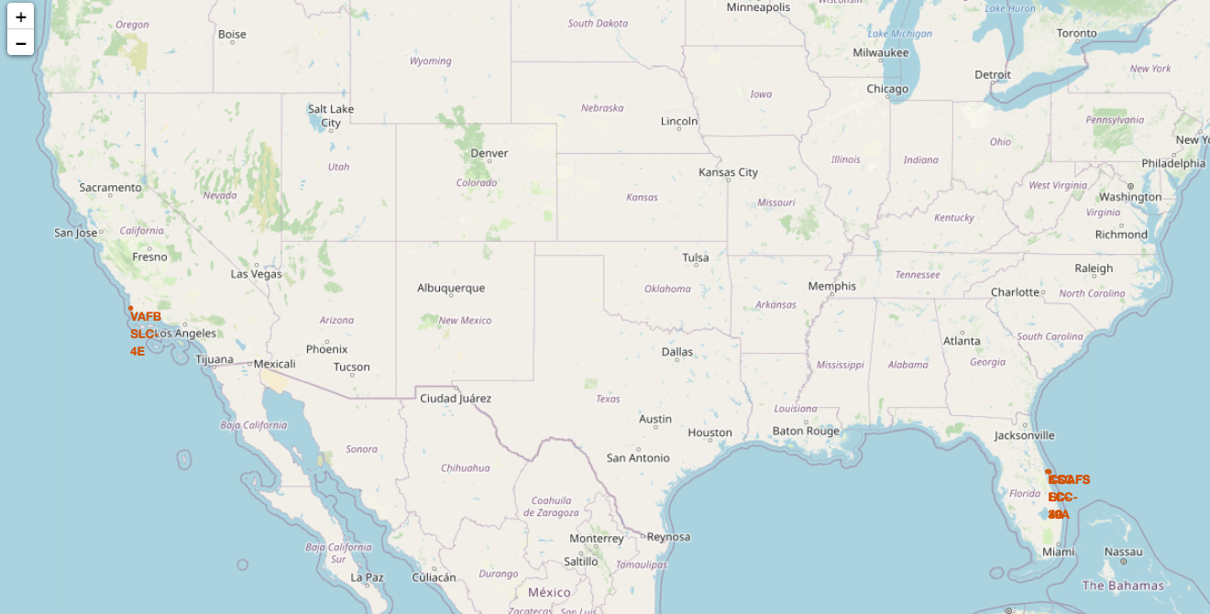
Launch Sites of SpaceX(on Folium Map)
Explain the important elements and findings on the screenshot
This folium map marks all launch sites
38

Slide 41
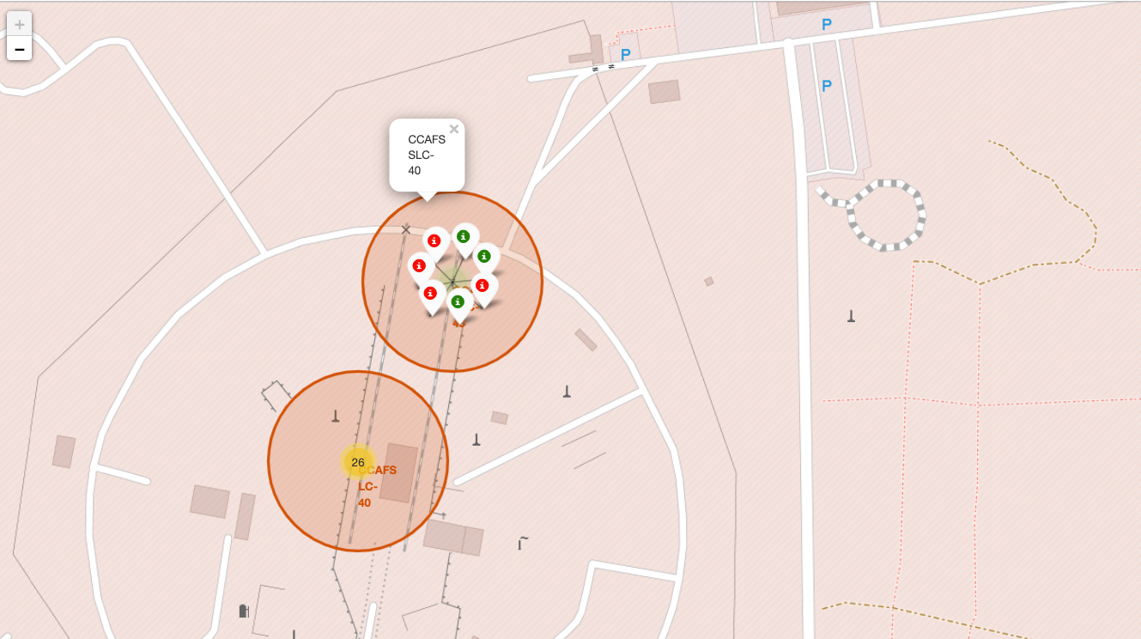
Successful and Failed launche(Folium)
It shows the successful launches in green and failed launches in Red for CCAFB SLC-40 site.
40

Slide 42
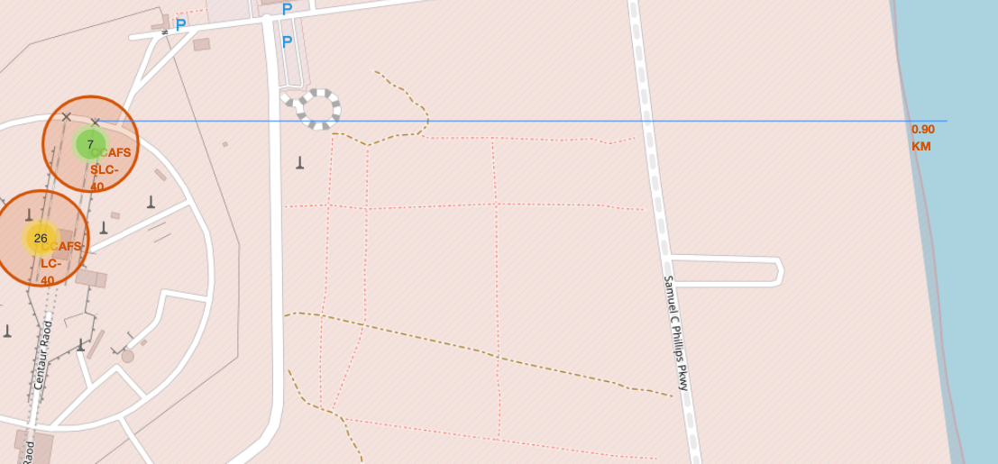
CCAFS SLC-40 to coastline
This folium map calulates the distance betSween launch site CCAFS SLC-40 to its nearest coastline point.
41

Slide 43

Section 4

Slide 44
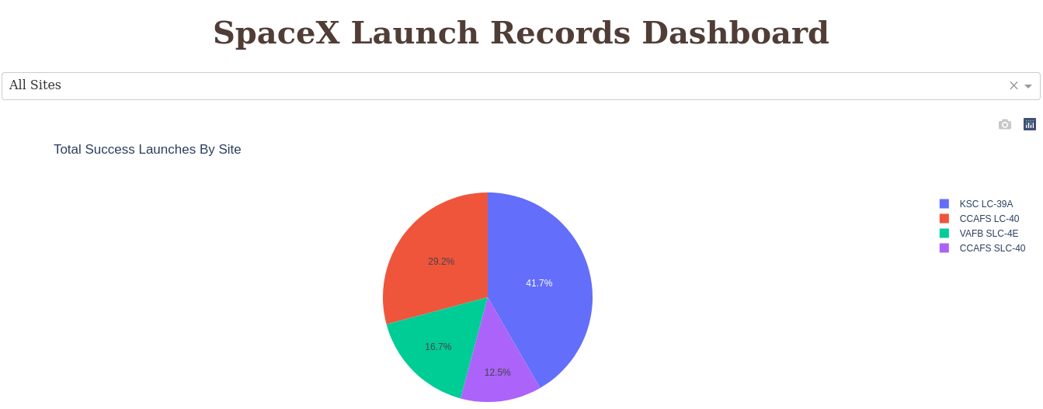
Launch success rate of different launch sites
Here it is to be noted that this graph shows the number of successful launches from each launch sites not the success rate of the launch site.
42

Slide 45
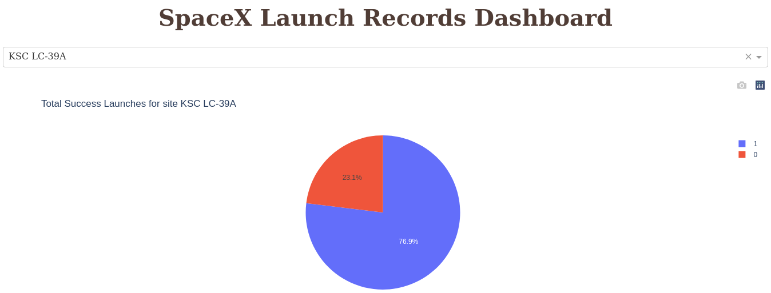
Launch site with the highest success rate
KSC LC-39A has the highest success rate among all spaceX launchsites.
<number>

Slide 46
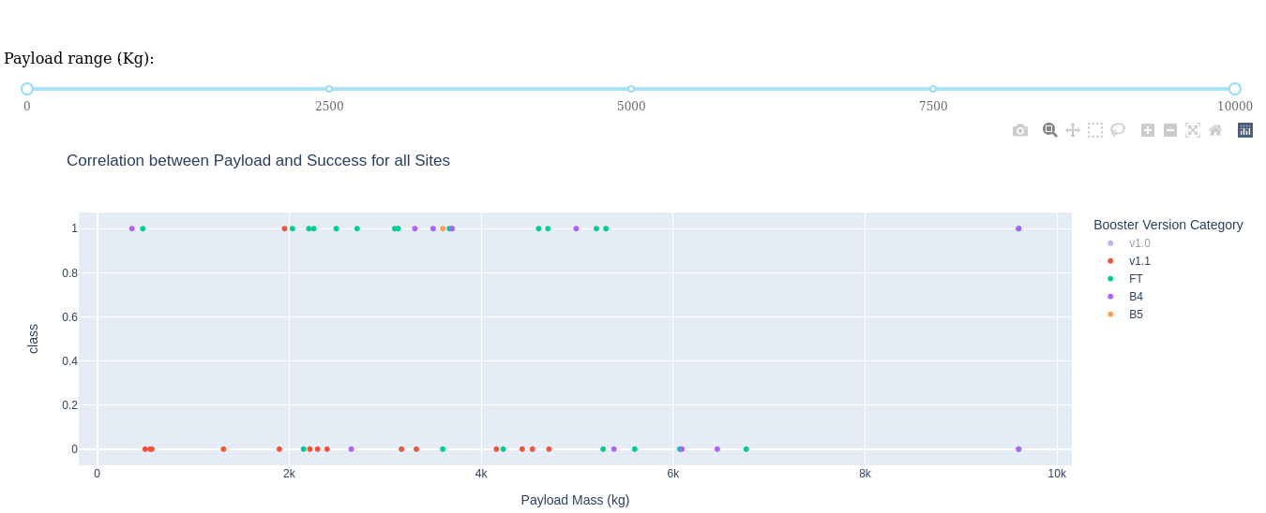
Payload vs Launch Outcome
We can see here that ‘FT’ booster version category has higher success rate.
<number>

Slide 47

Section 5

Slide 48
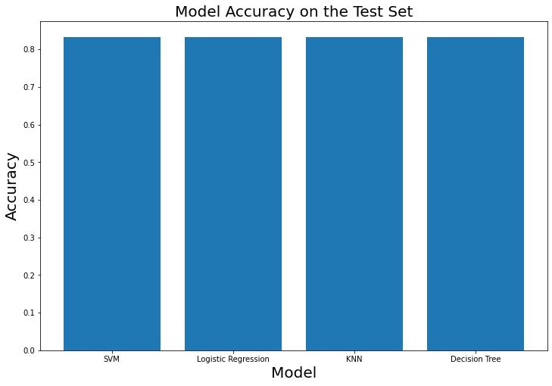
Classification Accuracy
As we can see, all the models perform equally well on test sets.
<number>

Slide 49
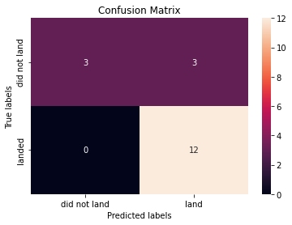
Confusion Matrix
This is the confusion matrix of KNN model as well as of others too since all of them performed equally upon being given the testset.
<number>

Slide 50
Conclusions
Mission success rate is improving each year as newer and more advanced rocket technology
coming to the market.
Space missions to geostationary orbit, high earth orbit, sun sun synchronous orbit and 1st
Lagrangian point are very likely to be successful.
Proximity of the launchsite to the coastline is a factor for mission success.
Newer version rocket boosters are very likely to make the mission successful.
Heavier payloads are more likely to make a successful mission.
<number>

Slide 51
Appendix
This is the link to this project capstone repository of mine.
Links to the websites of the software packages used are given below.
https://scikit-learn.org/stable/
https://python-visualization.github.io/folium/
https://plotly.com/
https://pandas.pydata.org/
https://matplotlib.org/
https://seaborn.pydata.org/
https://www.libreoffice.org/
https://colab.research.google.com/
50
Notes:
<number>

Slide 52


